Slide 1
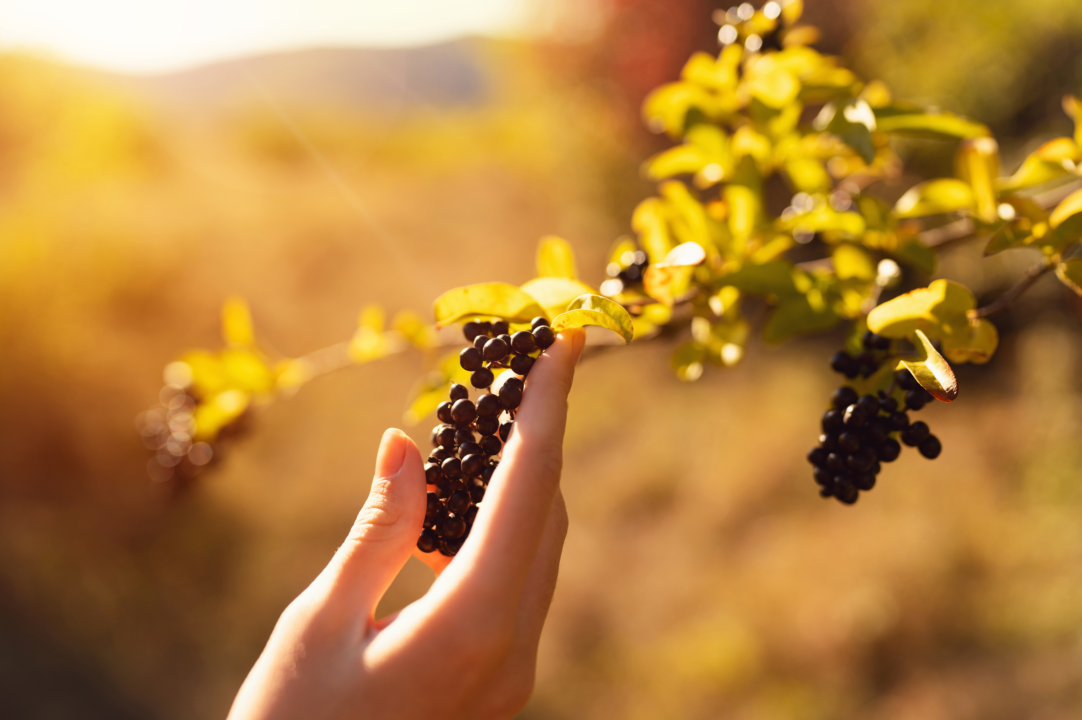

In Vino Veritas
Data Engineering
2
Project Presentation
Jonas | Marcell

Slide 2
Project motivation Overview
In Vino Veritas ~ 'in wine, there is truth‘
What is good wine? (Objective vs subjective perspective)
Big data in wine industry already relevant

Slide 3




Approach Step by step automated pipeline
Objective Perspective
Additional Data
Results
Subjective Perspective
Data Pipeline

Slide 4
Approach Step by step automated pipeline

Slide 5

Objective perspective Wine quality data set from 2009
Perspective
Judged through blind tasting by professional sommeliers
Analysis of chemical properties of underlying wines
Features
Chemical properties: 'fixed_acidity’, 'volatile_acidity’, 'citric_acid’, 'residual_sugar’, 'chlorides’, 'free_sulfur_dioxide', 'total_sulfur_dioxide’, 'density’, 'pH', 'sulphates’, 'alcohol'
Availability
Static (so no more updates)
Direct download or API

Slide 6
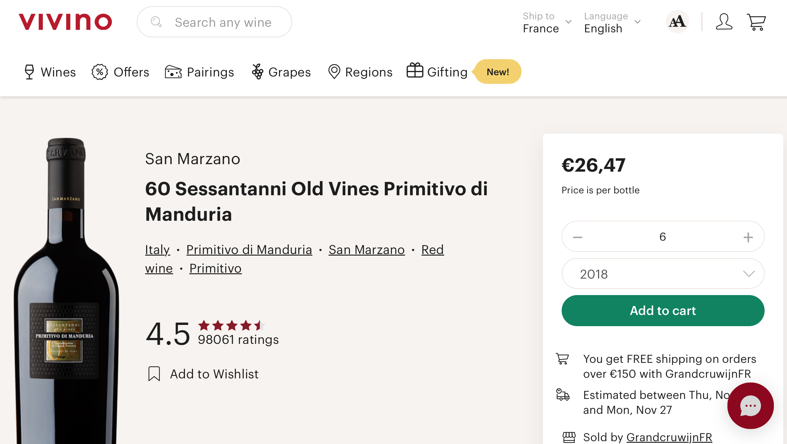
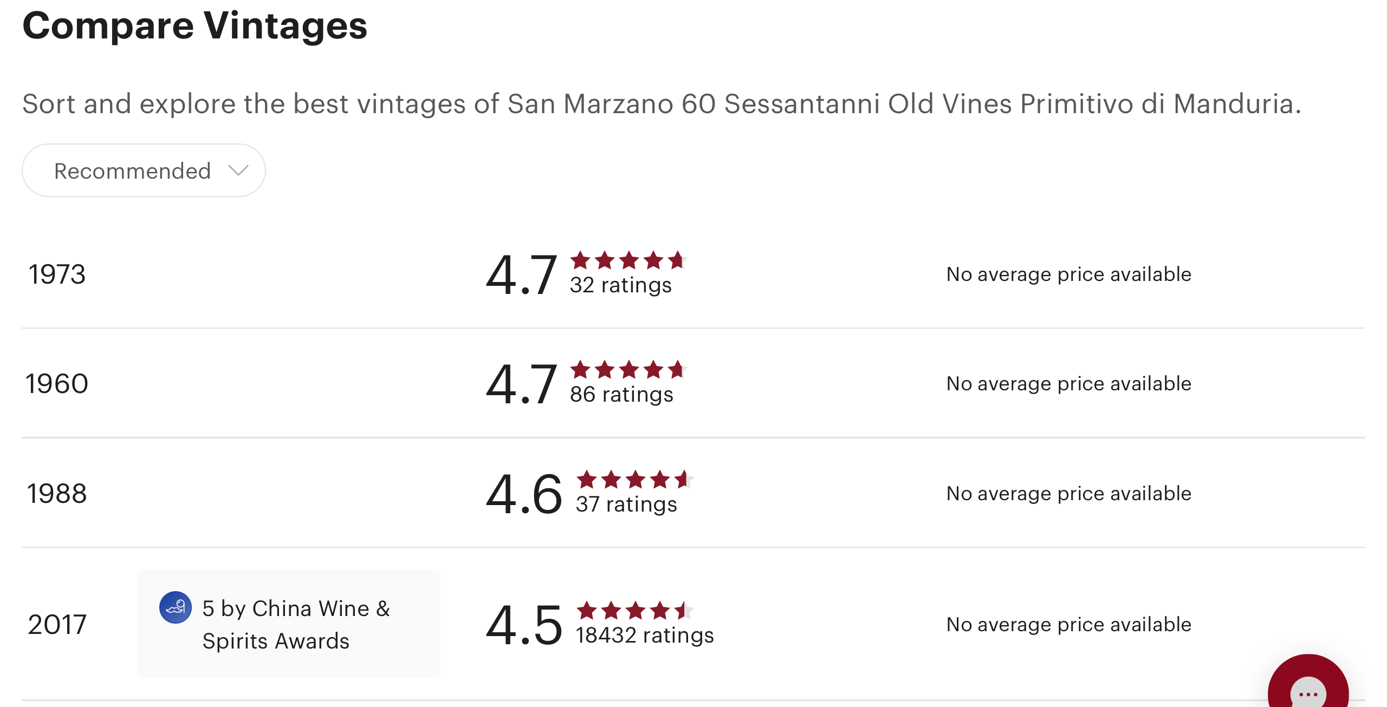
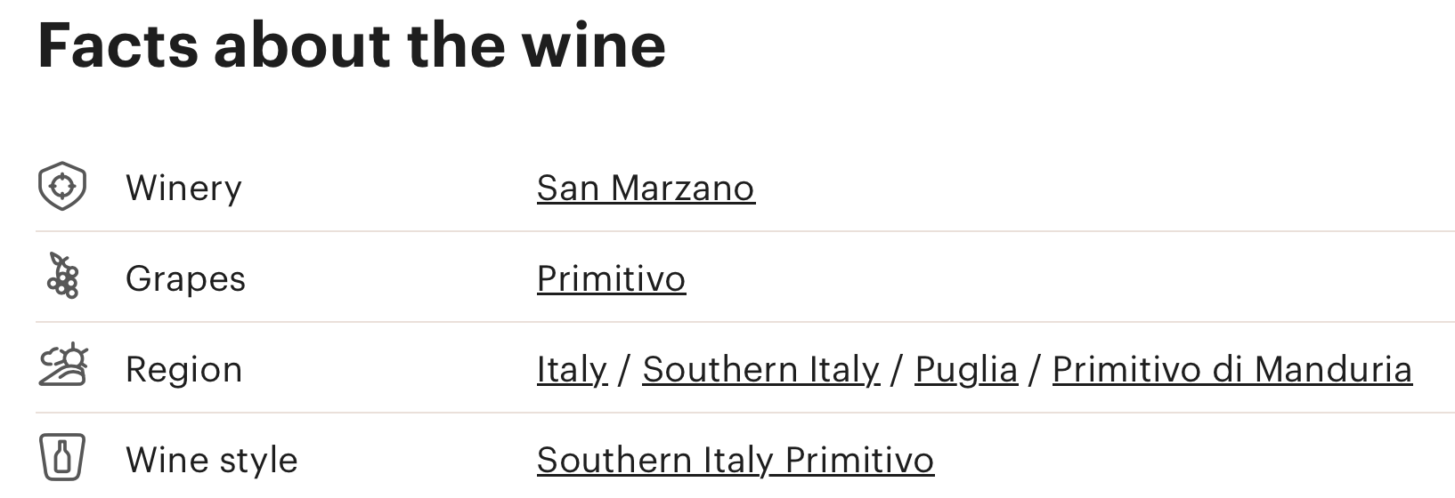
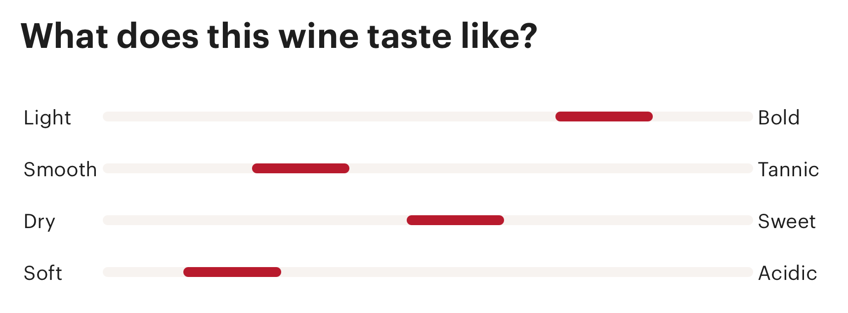
Subjective perspective Vivino.com ratings
Website
Based on users' ratings (like Amazon)
Different dimensions from rating, region, taste profile, …
Availability
Scraping with python (random walk exploration with resets)
Currently after 20min ~ 10k vines
Already structured output

Slide 7
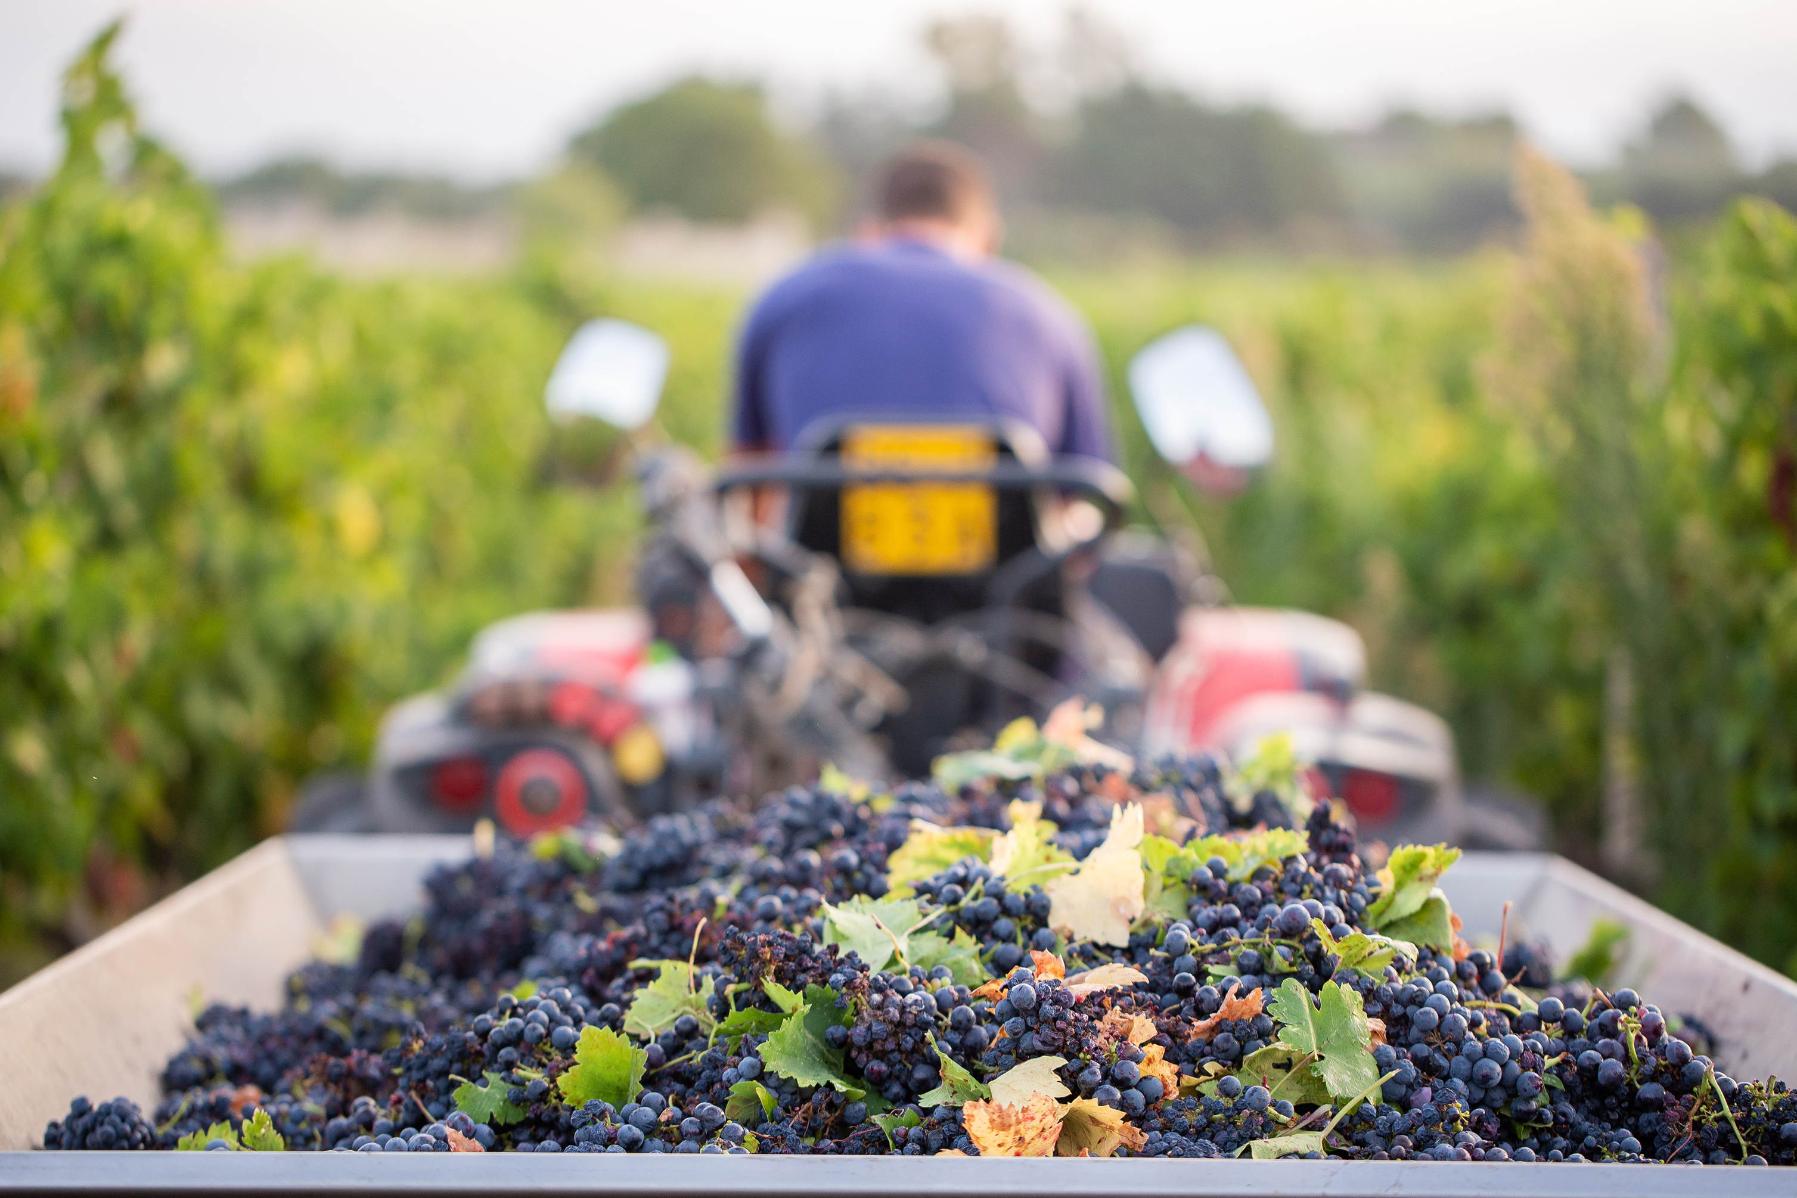
Additional Data (1) Wine harvest per country
Feature
Amount of harvest as indicator for good year
But quantity != quality
Availability
Lagging data (-2 years) provided by Food and Agriculture Organization Corporate Statistical Database (FAOSTAT)
Direct download or API
Source: PowerPoint Stock images

Slide 8
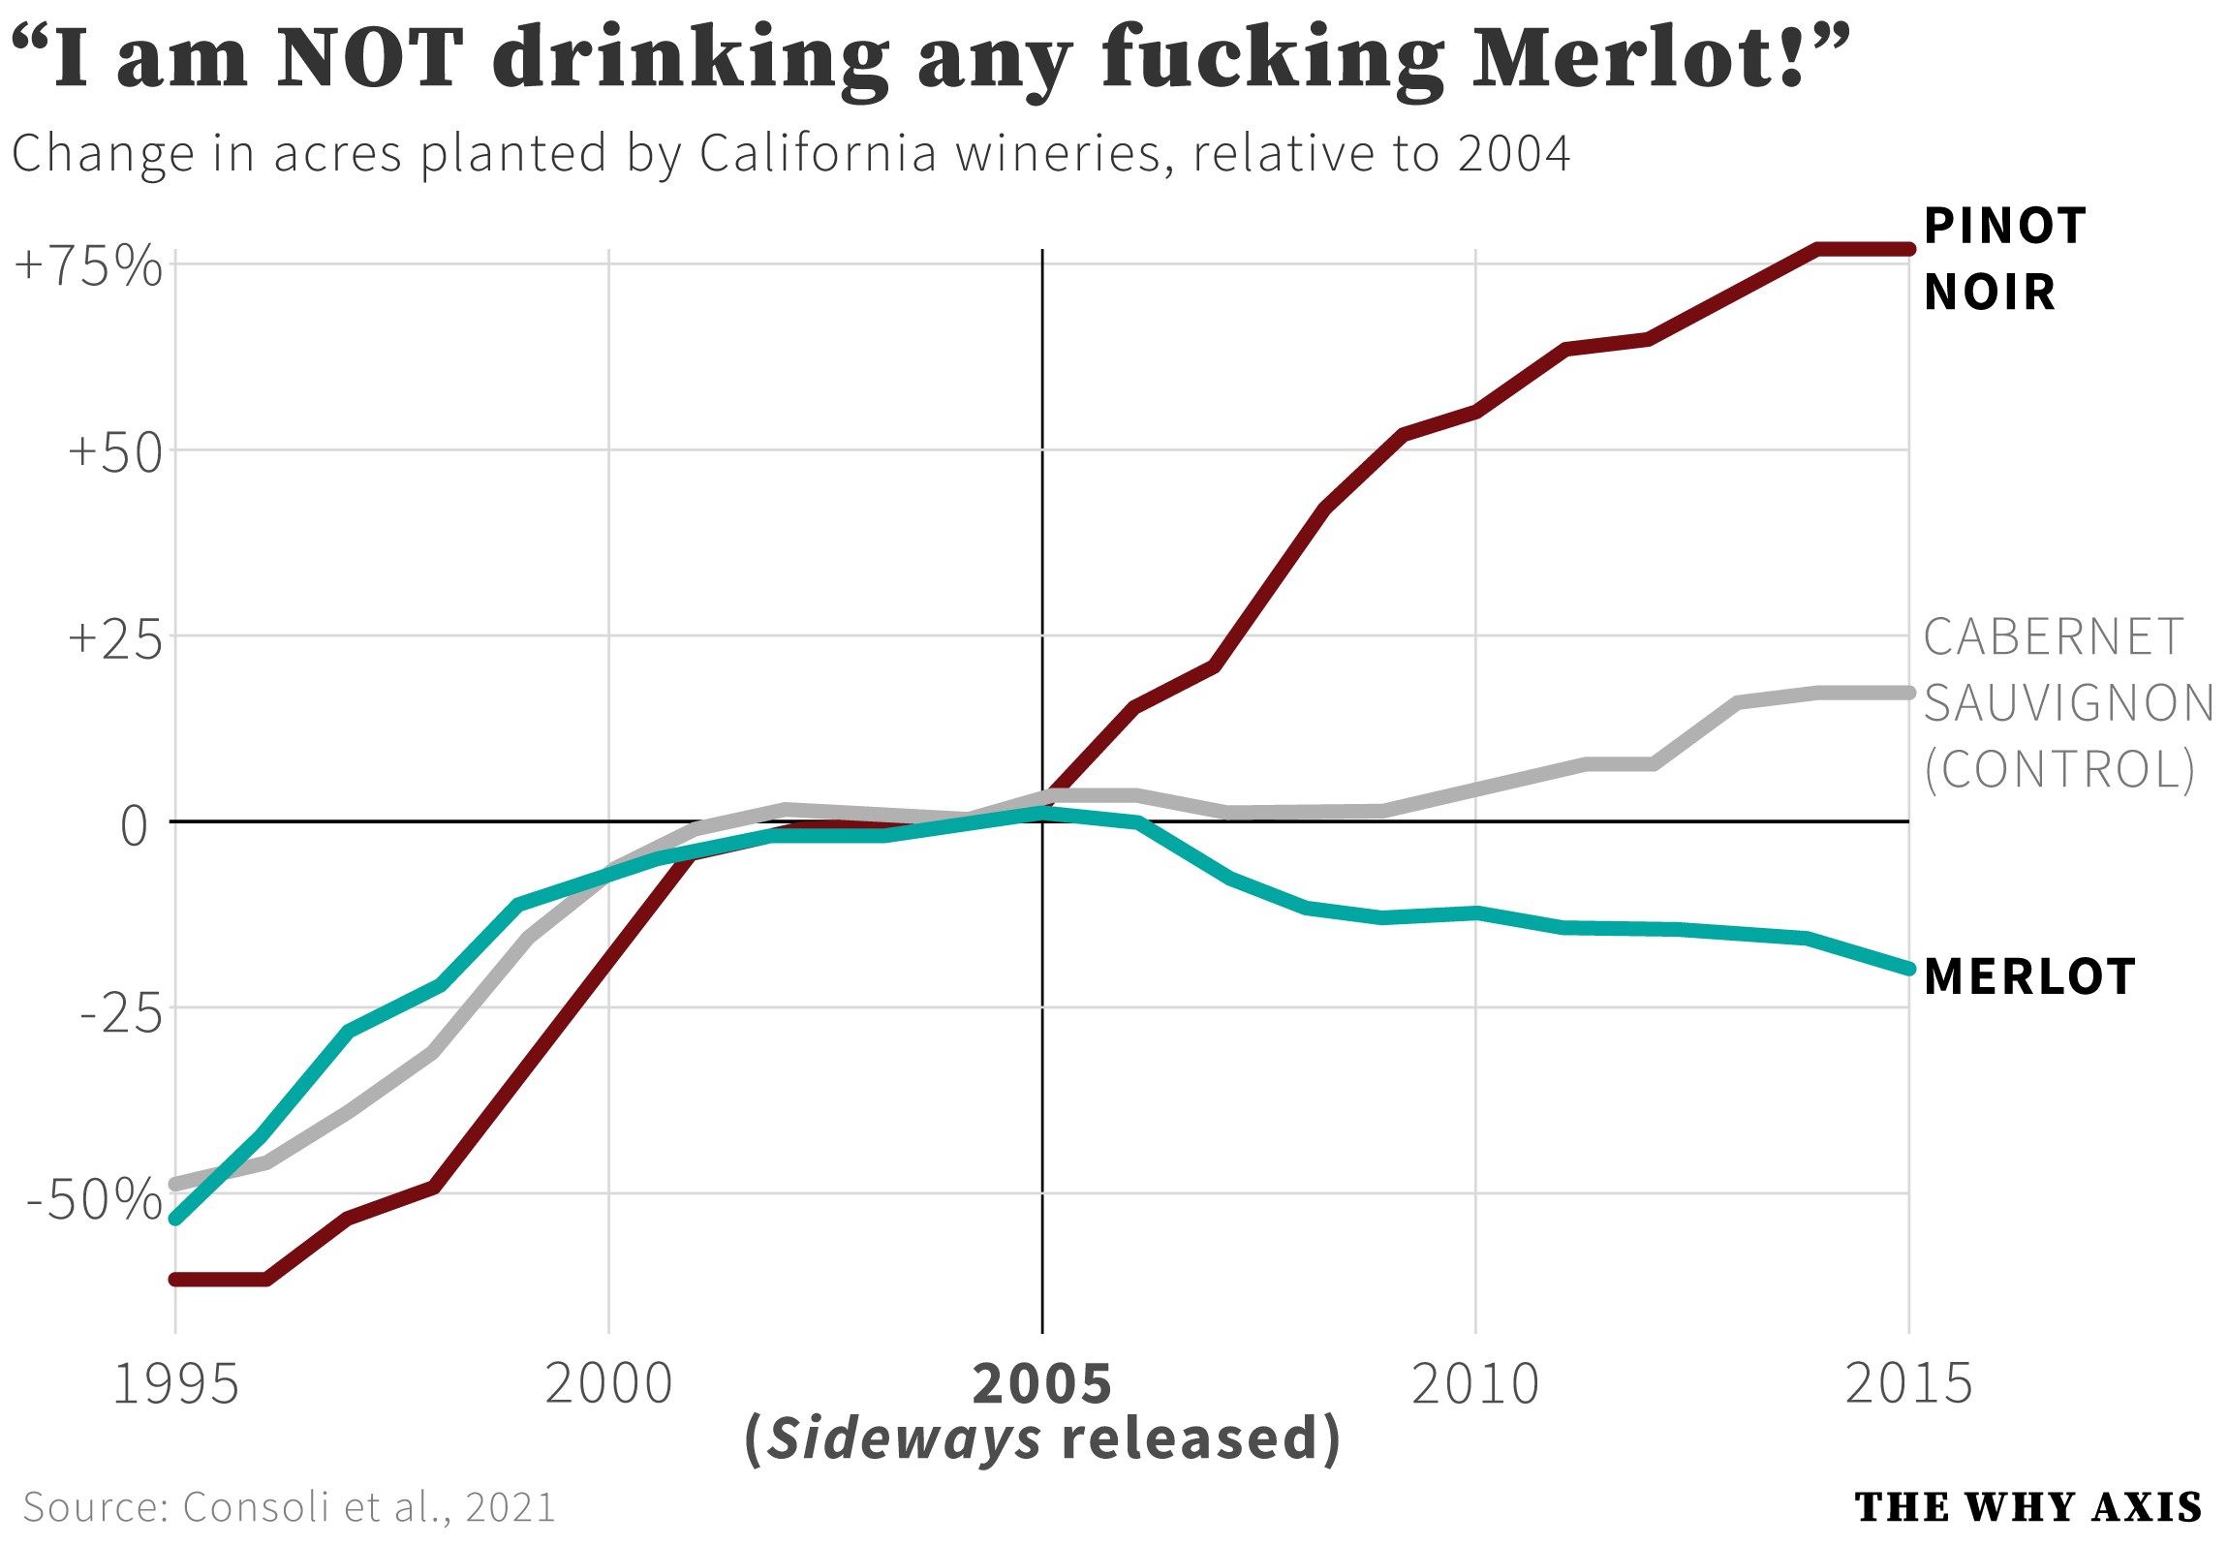
Additional Data (2) Google trends
Feature
Google Trends analyses the popularity of search queries in Google Search
Used to show which wine was trending
The “Sideways” Effect
Availability
Generation of links to be scraped or through unofficial Python API
Source: https://www.resetera.com/threads/how-paul-giamatti-broke-the-california-wine-industry.546245/

Slide 9



Additional Data (3) Weather data based on region
Feature
GPS location from vivino.com region via Geopy
Weather time series from GPS via meteostat
Time series != feature
Matryoshka Approach: API in API
Availability
Both through Python API
Data cleaning necessary for Geopy
Meteostat not always available for region
Notes:
#Number of days below a certain temp (0 and 10) during growth like frost in the spring
#number of days above a certain temp (35) during growth like drought during summer
#Growth period: may 11th - september 20th #https://en.wikipedia.org/wiki/Harvest_(wine)

Slide 10
Additional Data (3) Weather data based on region
“
A fairly cold winter, a spring with alternating periods of sunshine and occasional rain, a fairly hot and dry summer with the odd shower to ward off water stress, and rain-free harvesting… conditions like these will virtually guarantee a good year.
– https://www.idealwine.info/conditions-for-great-wine/
„
Notes:
#Number of days below a certain temp (0 and 10) during growth like frost in the spring
#number of days above a certain temp (35) during growth like drought during summer
#Growth period: may 11th - september 20th #https://en.wikipedia.org/wiki/Harvest_(wine)

Slide 11
Additional Data (3) Weather data based on region
“
At temperatures below 10°C and above 35°C, photosynthesis will be disrupted, and vines will not grow properly.
– https://www.idealwine.info/conditions-necessary-great-wine-part-12/
„
Notes:
#Number of days below a certain temp (0 and 10) during growth like frost in the spring
#number of days above a certain temp (35) during growth like drought during summer
#Growth period: may 11th - september 20th #https://en.wikipedia.org/wiki/Harvest_(wine)

Slide 12
Additional Data (3) Weather data based on region
“
Vines need between 400 and 600 mm of rain per year. […]
A regular supply of water throughout the growth cycle is needed for a high-quality crop.
– https://www.idealwine.info/conditions-for-great-wine/
„
Notes:
#whats the avg rainfall
#number of days without rain
#number of days with continues rain

Slide 13
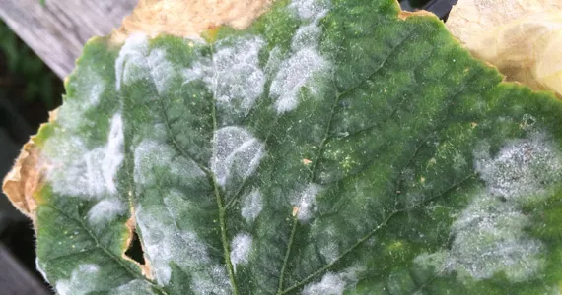
Additional Data (3) Weather data based on region
“
Too much rain and damp during the May-July period can lead to the appearance of diseases such as mildew or oidium, which are caused by the growth of tiny fungi.
– https://www.idealwine.info/conditions-for-great-wine/
„
Source: PowerPoint Stock images
Notes:
#whats the rainfall during these months

Slide 14
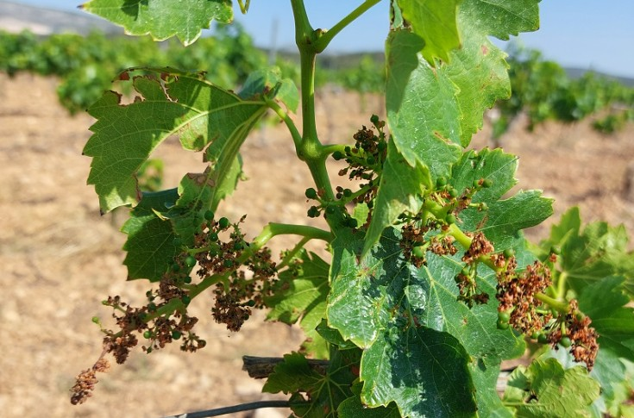
Additional Data (3) Weather data based on region
“
If there is rain or […] strong wind during flowering, the pollen will be unable to achieve its task of pollinating the flowers. This is known as coulure.
– https://www.idealwine.info/conditions-for-great-wine/
„
Source: PowerPoint Stock images
Notes:
#whats the rainfall during these months

Slide 15
Additional Data (3) Weather data based on region
“
[…] excessive rain just before or during harvesting can ruin a hitherto promising vintage.
– https://www.idealwine.info/conditions-for-great-wine/
„
Notes:
#whats the rainfall during these months

Slide 16





Data Pipeline Automated pipeline from ingestion to analysis
Overview
Backbone: vivino.com
Enriched by different time series:
Weather Data
Grape Trends
Harvest Yield
Separated: objective wine quality
Objective
Airflow pipeline
Databases: Postgres, Neo4j, redis
Cleaning, wrangling, logfiles
In depth analysis to find veritas

Slide 17
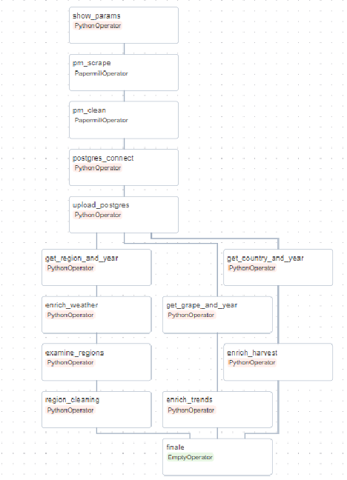







Data Pipeline Evaluation of trained models
Ingestion
Wrangling
Production
Append hashmap to check if exists
vivino.com
Save Scraped data
Clean and delete if exists
Append final DB
If exists: nothing
Get Grape + Year Tuples
API: Trends
Else: append generated features
If exists: nothing
Get Country + Year Tuples
API: Harvest
Else: append generated features
If exists: nothing
Get Region + Year Tuples
APIs: Geo + Weather
Else: append generated features
1101001
0001010
0110100
1011001
If NaN: Log Region for cleaning
API: Quality
Load and save

Slide 18
Data Pipeline Evaluation of trained models
Ingestion
Wrangling
Production
Append hashmap to check if exists
vivino.com
Save Scraped data
Clean and delete if exists
Append final DB
If exists: nothing
Get Grape + Year Tuples
API: Trends
Else: append generated features
If exists: nothing
Get Country + Year Tuples
API: Harvest
Else: append generated features
If exists: nothing
Get Region + Year Tuples
APIs: Geo + Weather
Else: append generated features
1101001
0001010
0110100
1011001
If NaN: Log Region for cleaning
API: Quality
Load and save

Slide 19
Data Pipeline Evaluation of trained models
Ingestion
Wrangling
Production
Append hashmap to check if exists
vivino.com
Save Scraped data
Clean and delete if exists
Append final DB
If exists: nothing
Get Grape + Year Tuples
API: Trends
Else: append generated features
If exists: nothing
Get Country + Year Tuples
API: Harvest
Else: append generated features
If exists: nothing
Get Region + Year Tuples
APIs: Geo + Weather
Else: append generated features
1101001
0001010
0110100
1011001
If NaN: Log Region for cleaning
API: Quality
Load and save

Slide 20
Data Pipeline Evaluation of trained models
Ingestion
Wrangling
Production
Append hashmap to check if exists
vivino.com
Save Scraped data
Clean and delete if exists
Append final DB
If exists: nothing
Get Grape + Year Tuples
API: Trends
Else: append generated features
If exists: nothing
Get Country + Year Tuples
API: Harvest
Else: append generated features
If exists: nothing
Get Region + Year Tuples
APIs: Geo + Weather
Else: append generated features
1101001
0001010
0110100
1011001
If NaN: Log Region for cleaning
API: Quality
Load and save

Slide 21
Data Pipeline Evaluation of trained models
Ingestion
Wrangling
Production
Append hashmap to check if exists
vivino.com
Save Scraped data
Clean and delete if exists
Append final DB
If exists: nothing
Get Grape + Year Tuples
API: Trends
Else: append generated features
If exists: nothing
Get Country + Year Tuples
API: Harvest
Else: append generated features
If exists: nothing
Get Region + Year Tuples
APIs: Geo + Weather
Else: append generated features
1101001
0001010
0110100
1011001
If NaN: Log Region for cleaning
API: Quality
Load and save

Slide 22
Data Pipeline Evaluation of trained models
Ingestion
Wrangling
Production
Append hashmap to check if exists
vivino.com
Save Scraped data
Clean and delete if exists
Append final DB
If exists: nothing
Get Grape + Year Tuples
API: Trends
Else: append generated features
If exists: nothing
Get Country + Year Tuples
API: Harvest
Else: append generated features
If exists: nothing
Get Region + Year Tuples
APIs: Geo + Weather
Else: append generated features
1101001
0001010
0110100
1011001
If NaN: Log Region for cleaning
API: Quality
Load and save

Slide 23
Data Pipeline Evaluation of trained models
Ingestion
Wrangling
Production
Append hashmap to check if exists
vivino.com
Save Scraped data
Clean and delete if exists
Append final DB
If exists: nothing
Get Grape + Year Tuples
API: Trends
Else: append generated features
If exists: nothing
Get Country + Year Tuples
API: Harvest
Else: append generated features
If exists: nothing
Get Region + Year Tuples
APIs: Geo + Weather
Else: append generated features
1101001
0001010
0110100
1011001
If NaN: Log Region for cleaning
API: Quality
Load and save

Slide 24
Data Pipeline Evaluation of trained models
Ingestion
Wrangling
Production
Append hashmap to check if exists
vivino.com
Save Scraped data
Clean and delete if exists
Append final DB
If exists: nothing
Get Grape + Year Tuples
API: Trends
Else: append generated features
If exists: nothing
Get Country + Year Tuples
API: Harvest
Else: append generated features
If exists: nothing
Get Region + Year Tuples
APIs: Geo + Weather
Else: append generated features
1101001
0001010
0110100
1011001
If NaN: Log Region for cleaning
API: Quality
Load and save

Slide 25
Results Questions and visualisations
Questions
Which countries have the best rated wines? → Box Plot by country
Are expensive wines better? → 3 Scatter plots by category (red whit sparkling)
Are old wines better? → same as above (maybe with boxplots)
How does good wine taste and what chemical characteristics does it have? → Box/Distribution plots and ANOVA
How do the variables influence each other? → Click Me (interactive Bayesian network)

Slide 26
Results Questions and visualisations
Questions
Which countries have the best rated wines? → Box Plot by country
Are expensive wines better? → 3 Scatter plots by category (red whit sparkling)
Are old wines better? → same as above (maybe with boxplots)
How does good wine taste and what chemical characteristics does it have? → Box/Distribution plots and ANOVA
How do the variables influence each other? → Click Me (interactive Bayesian network)

Slide 27
Results Questions and visualisations
Questions
Which countries have the best rated wines? → Box Plot by country
Are expensive wines better? → 3 Scatter plots by category (red whit sparkling)
Are old wines better? → same as above (maybe with boxplots)
How does good wine taste and what chemical characteristics does it have? → Box/Distribution plots and ANOVA
How do the variables influence each other? → Click Me (interactive Bayesian network)

Slide 28
Results Questions and visualisations
Questions
Which countries have the best rated wines? → Box Plot by country
Are expensive wines better? → 3 Scatter plots by category (red whit sparkling)
Are old wines better? → same as above (maybe with boxplots)
How does good wine taste and what chemical characteristics does it have? → Box/Distribution plots and ANOVA
How do the variables influence each other? → Click Me (interactive Bayesian network)

Slide 29
Results Questions and visualisations
Questions
Which countries have the best rated wines? → Box Plot by country
Are expensive wines better? → 3 Scatter plots by category (red whit sparkling)
Are old wines better? → same as above (maybe with boxplots)
How does good wine taste and what chemical characteristics does it have? → Box/Distribution plots and ANOVA
How do the variables influence each other? → Click Me (interactive Bayesian network)

Slide 30


Summary and Outlook Obstacles, dead ends and novel approaches
Obstacles
Data needs to be cleaned iteratively and parsing can easily end in duplicates
High dimensional data and many features
Obtaining sound and reliable weather data is more expensive than financial data?
Future ideas
Use (and parse) lists of “officially good” wine years (e.g., https://www.winespectator.com/vintage-charts) to select best weather features in terms of predictive models
Use non-free weather APIs
Try streaming instead of batch processing

Slide 31
Q
&
A

Slide 32

Fact Table (Vivino.com)
Harvest
'id’
'winery’
'name’
'country’
'vintage’
'region’
'wine_style’
'wine_type’
'wine_category’
'grape_type’
'grape_id’
'rating’
'review_count’
'price’
'acidity’
'fizziness’
'intensity’
'sweetness’
'tannin’
'scrape_date'
'country’
'vintage’
'harvest_area’
'harvest_grape’
'harvest_wine'
Weather
'vintage’
'region’
'vola_temp’
'vola_rain’
'longest_dry’
'longest_wet’
'avg_rain’
'count_above35’
'count_under10’
'count_under0’
'coulure_wind’
'june_rain'
Google Trends
'vintage’
'grape_type’
'median_trends’
'mean_trends'

